Slide 1

Introduction to Convolutional Neural Network (CNN)

Slide 2
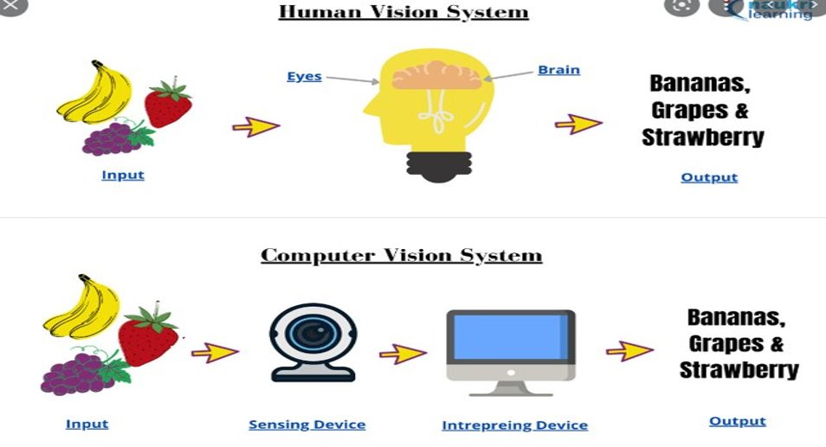

Slide 3

Pixel of eyes
576 megapixels
According to scientist and photographer Dr. Roger Clark, the resolution of the human eye is 576 megapixels. That's huge when you compare it to the 12 megapixels of an iPhone 7's camera

Slide 4
Basics of images
Pixels
An image is made of tiny, square-like elements called pixels. Even a small image can contain millions of such pixels of different colors.
Image properties
Every image has three main properties:
Size — This is the height and width of an image. It can be represented in centimeters, inches or even in pixels.
Color space — RGB color spaces.
Channel — This is an attribute of the color space. For example, RGB color space has three types of colors or attributes known as Red, Green and Blue (hence the name RGB).

Slide 5
RGB images vs grayscale images, Pixel values
It is important to distinguish between RGB images and grayscale images. An RGB image has three color channels: Red channel, Green channel and Blue channel. However, a grayscale image has just one channel.
The colors of an image are denoted by its pixel values. A pixel can have only one color but can be merged to create multiple colors.
In a grayscale image where there is only one channel, a pixel value has just a single number ranging from 0 to 255 (both inclusive). The pixel value 0 represents black and the pixel value 255 represents white. A pixel value in a grayscale image can be represented as follows:

Slide 6
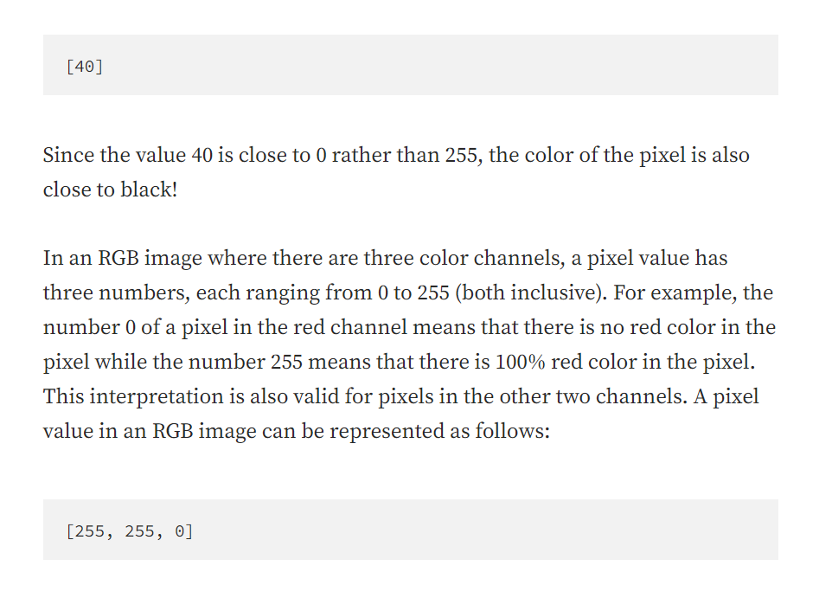

Slide 7
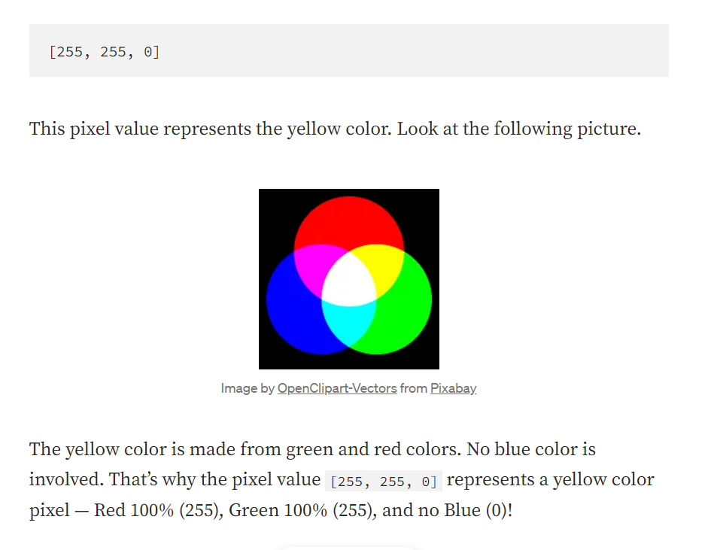

Slide 8
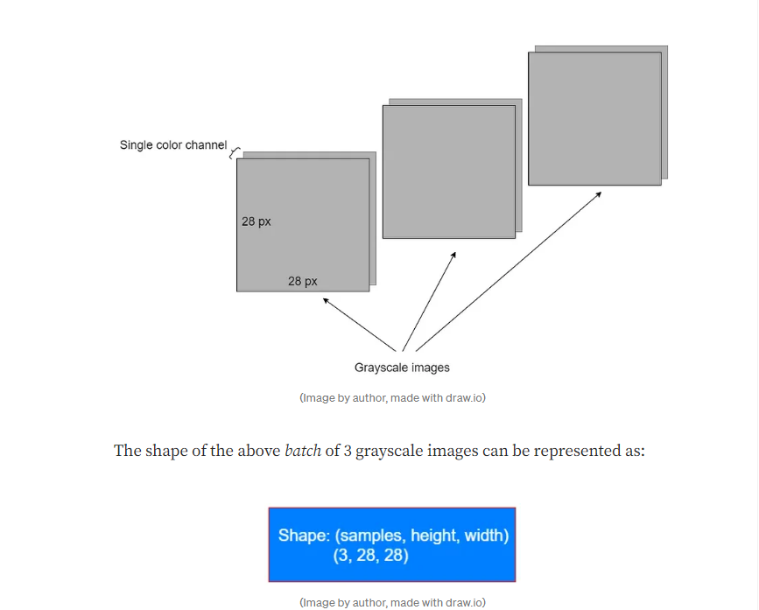
Shape of Images

Slide 9
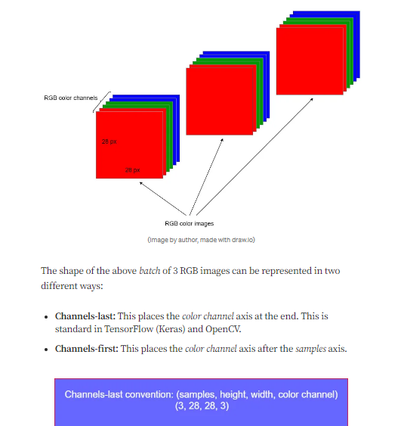

Slide 10
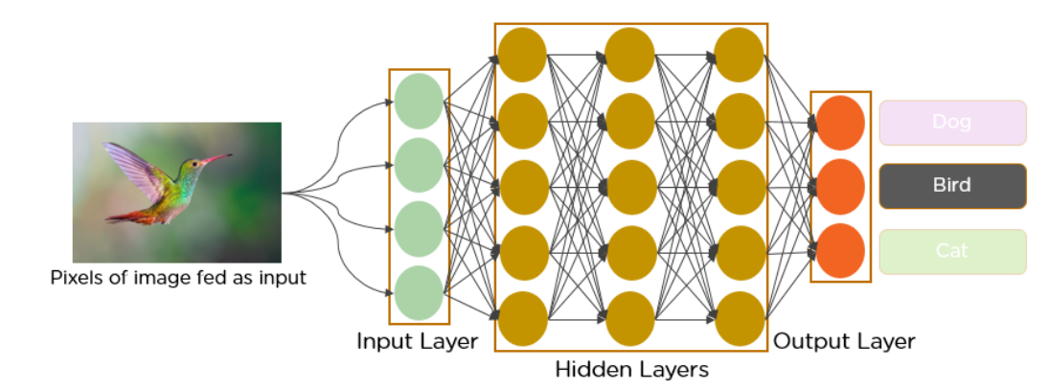

Slide 11
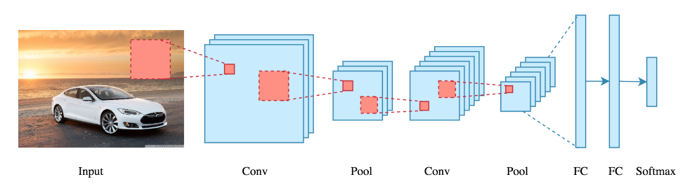

Slide 12
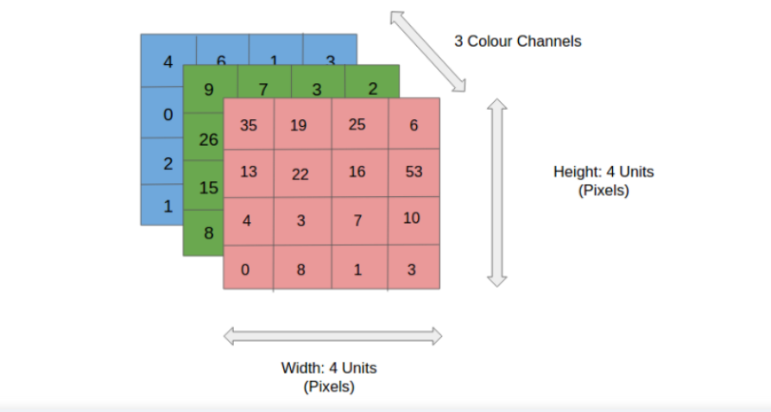
How does it work?

Slide 13
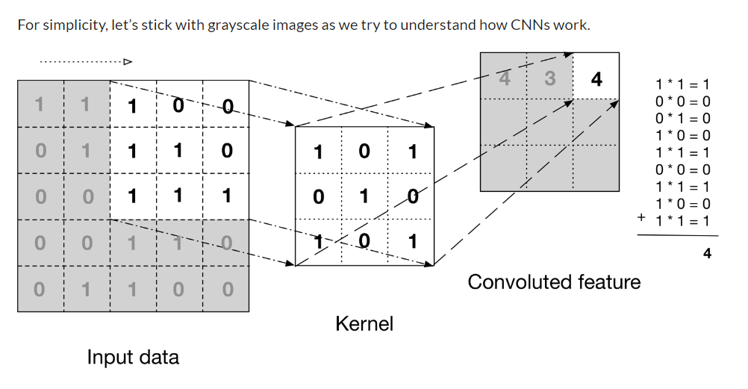

Slide 14
Implementations
https://editor.analyticsvidhya.com/uploads/419681_GcI7G-JLAQiEoCON7xFbhg.gif
https://editor.analyticsvidhya.com/uploads/556091_ciDgQEjViWLnCbmX-EeSrA.gif
https://editor.analyticsvidhya.com/uploads/52794neural-networks-layers-visualization.jpg

Slide 15
What’s a pooling layer?
https://editor.analyticsvidhya.com/uploads/254781_uoWYsCV5vBU8SHFPAPao-w.gif

Slide 16
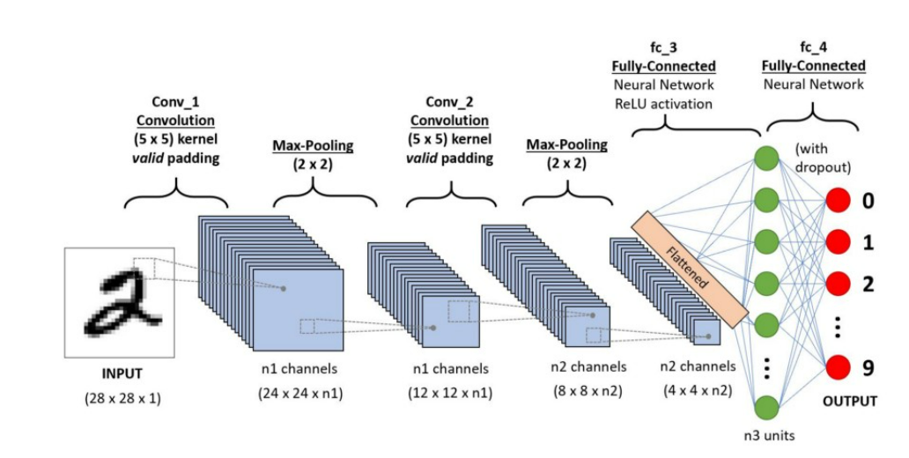

Slide 17
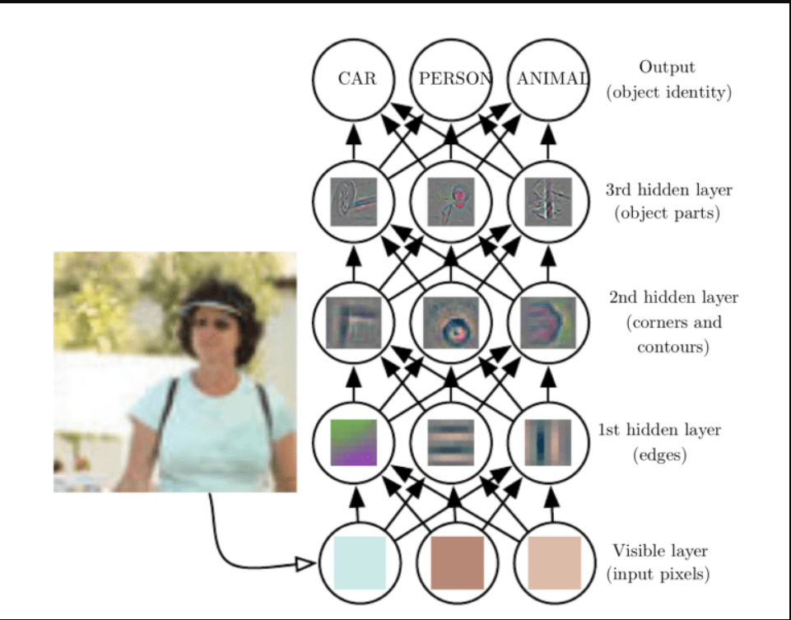

Slide 18
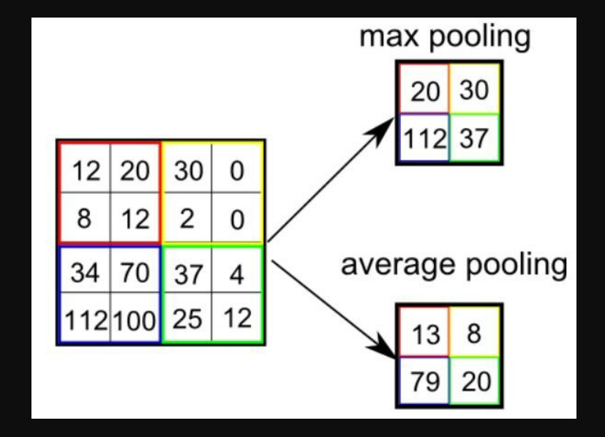

Slide 19
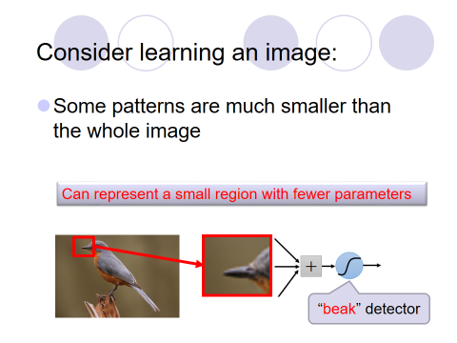

Slide 20
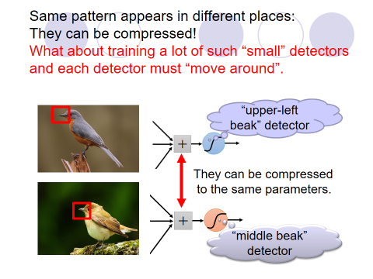

Slide 21
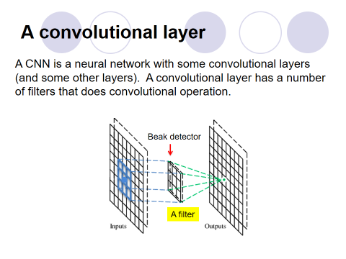

Slide 22
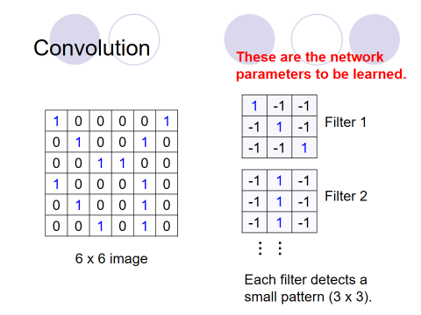

Slide 23
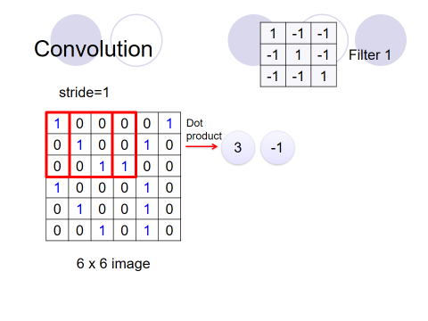

Slide 24
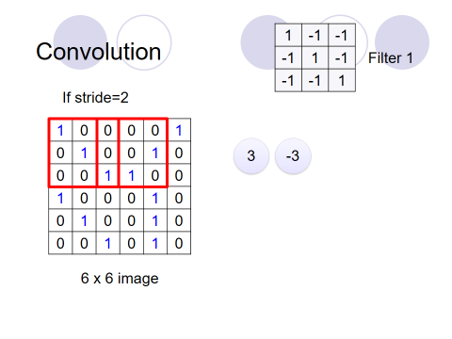

Slide 25
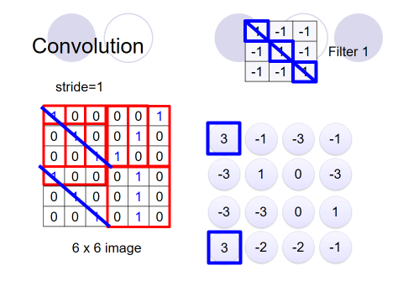

Slide 26
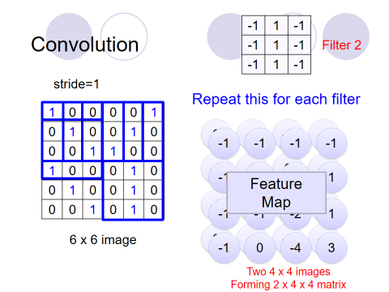

Slide 27
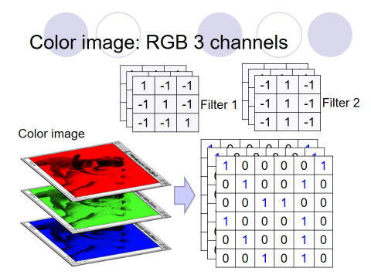

Slide 28
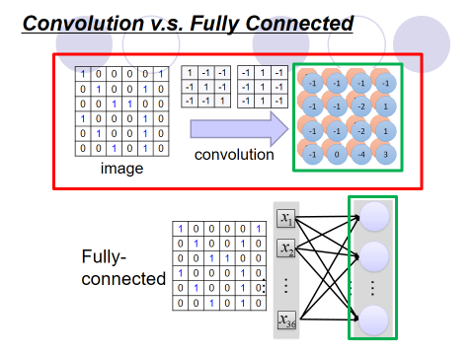

Slide 29
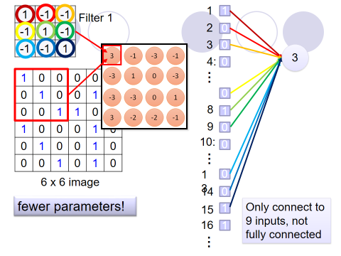

Slide 30
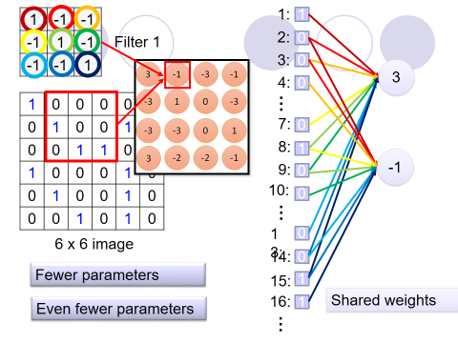

Slide 31
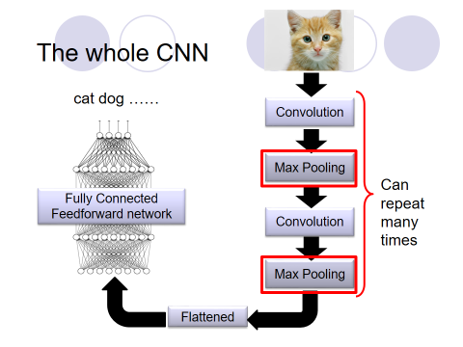

Slide 32
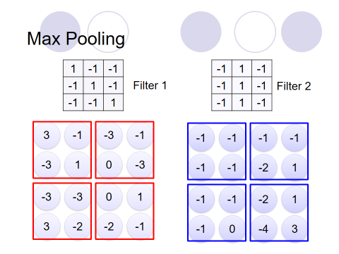

Slide 33
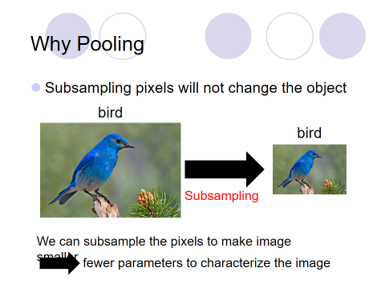

Slide 34
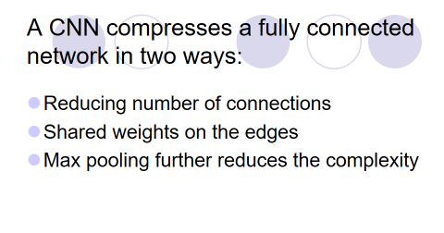

Slide 35
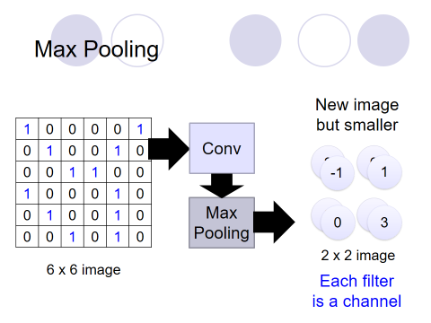

Slide 36
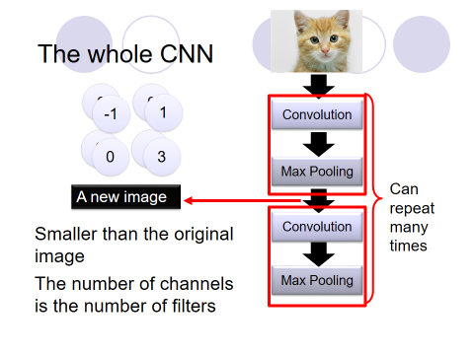

Slide 37
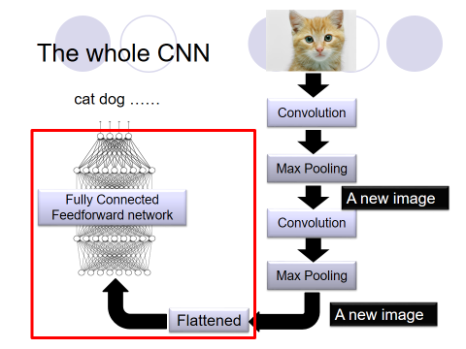

Slide 38
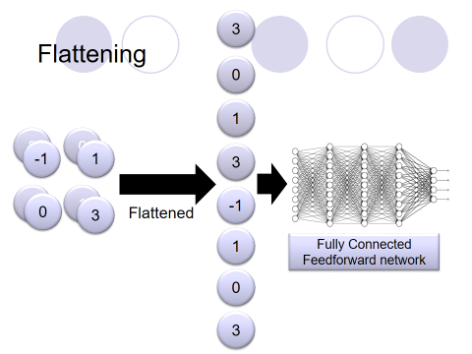

Slide 39
Visualizations in 2D and 3D
https://adamharley.com/nn_vis/cnn/2d.html
https://adamharley.com/nn_vis/cnn/3d.html

Slide 40
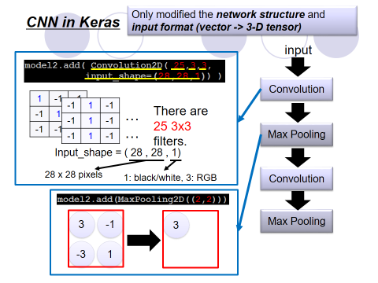

Slide 41
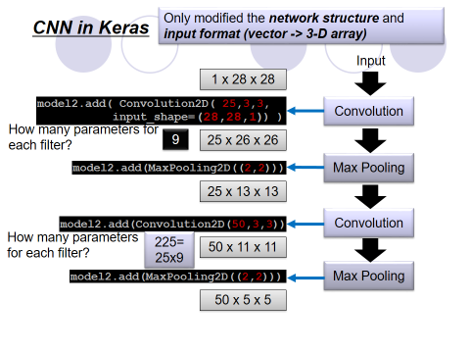

Slide 42
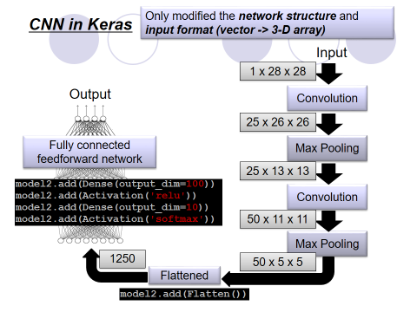

Slide 43
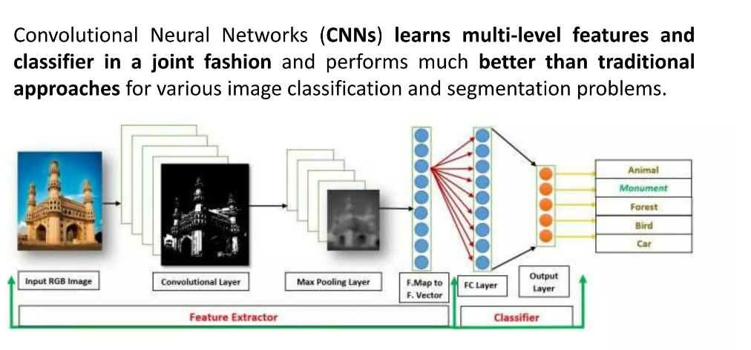

Slide 44
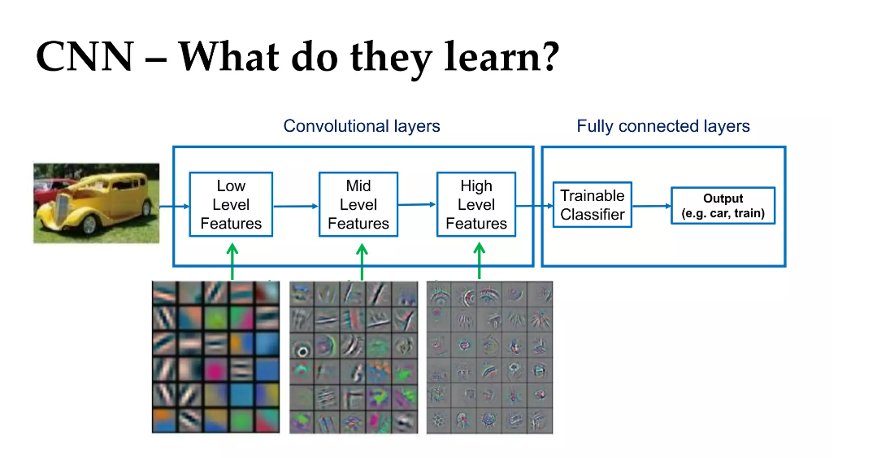

Slide 45
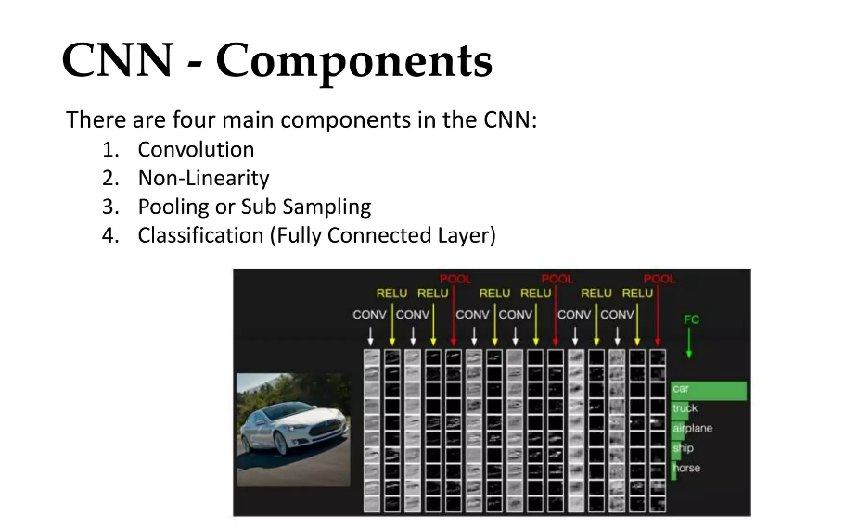

Slide 46
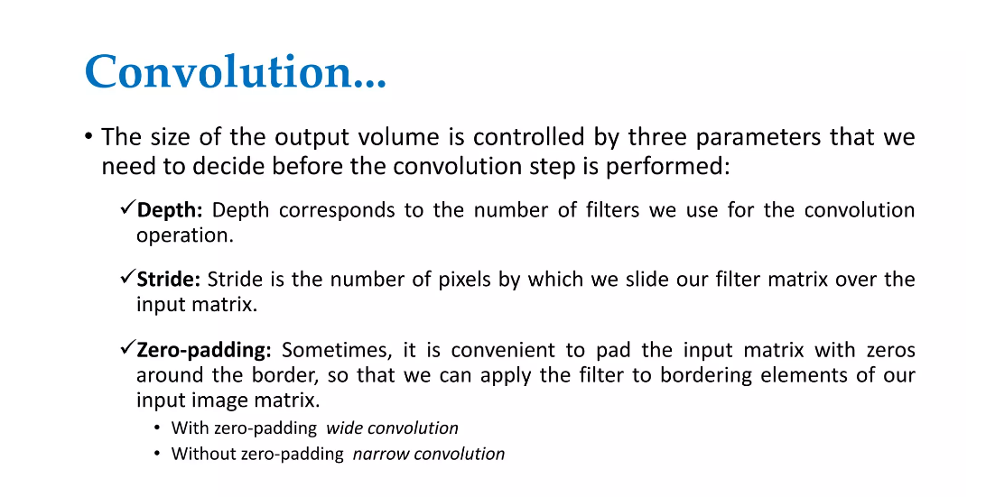

Slide 47
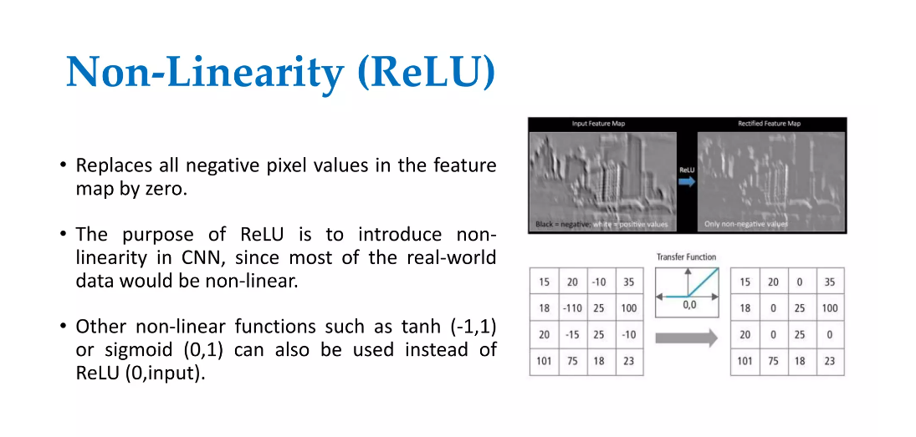

Slide 48
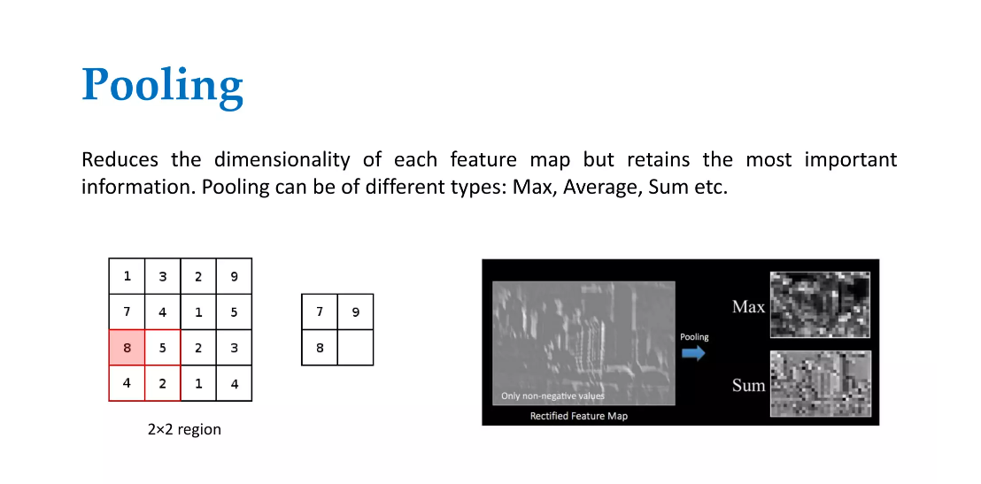

Slide 49
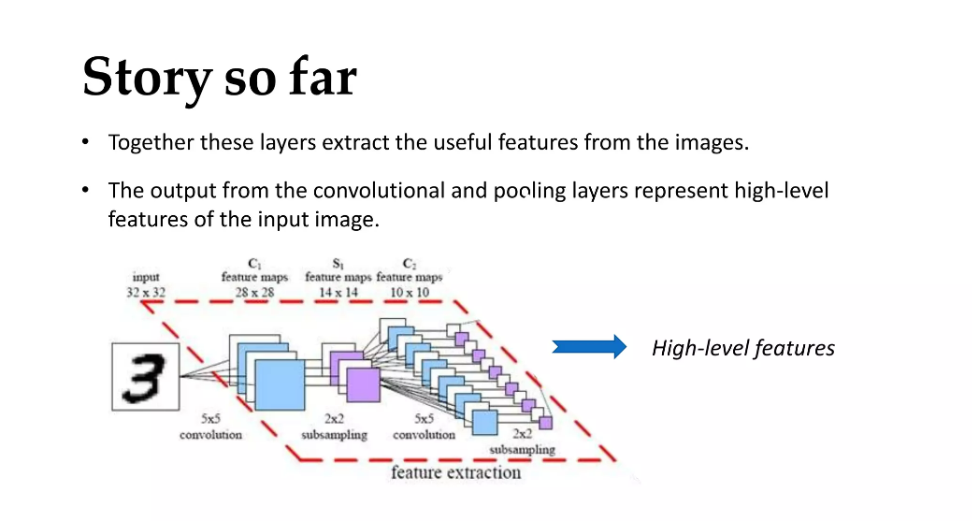

Slide 50
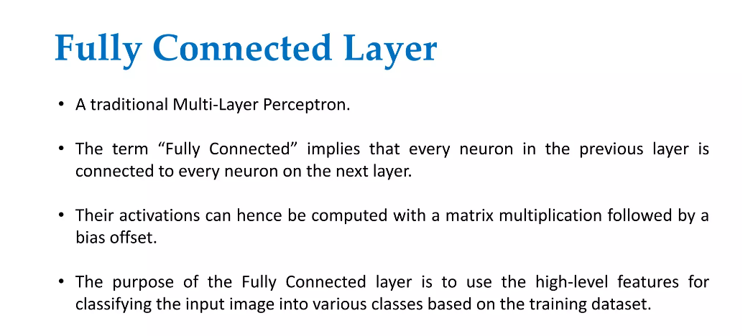

Slide 51
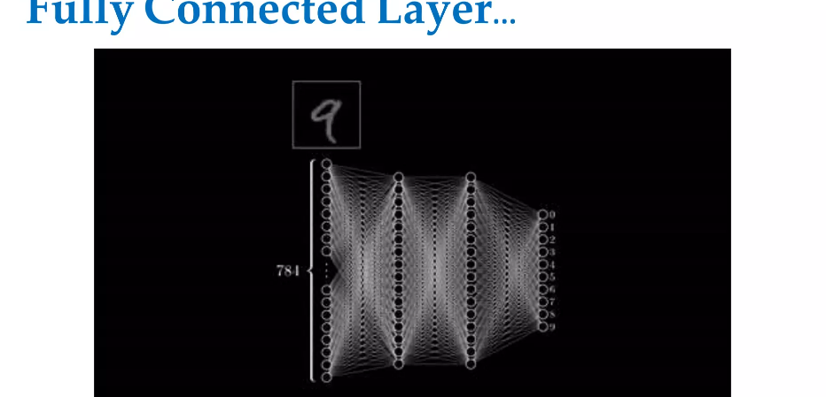

Slide 52
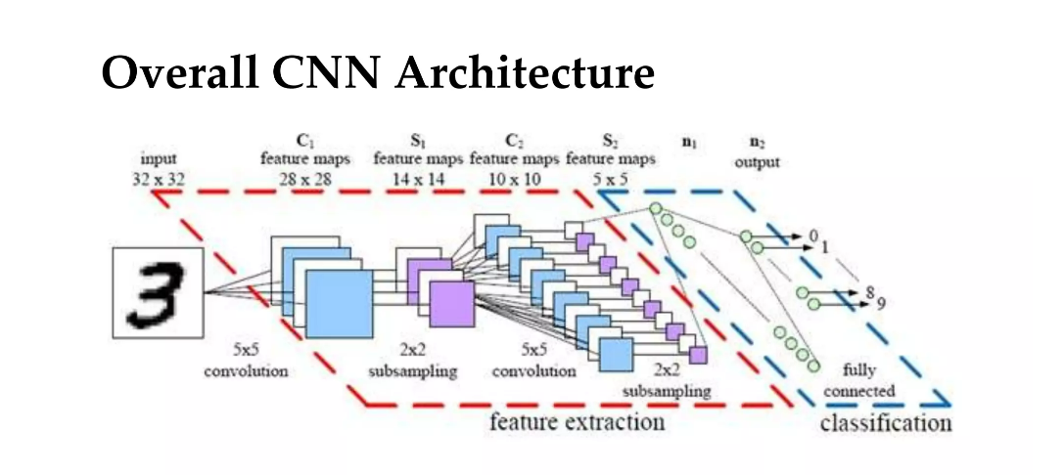

Slide 53
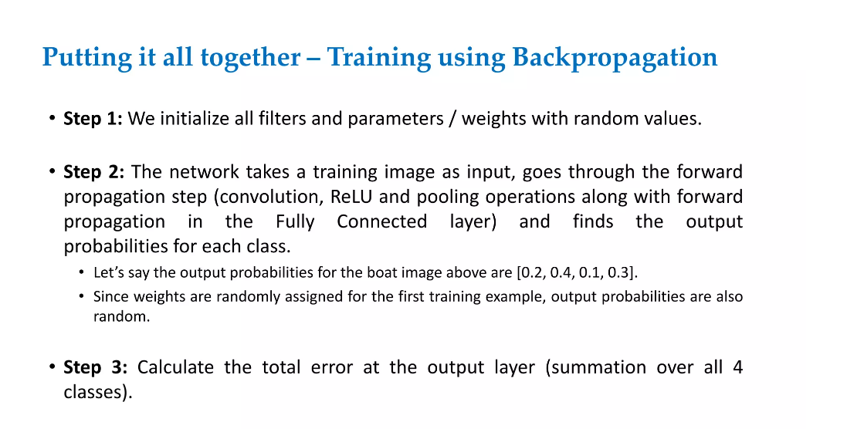

Slide 54
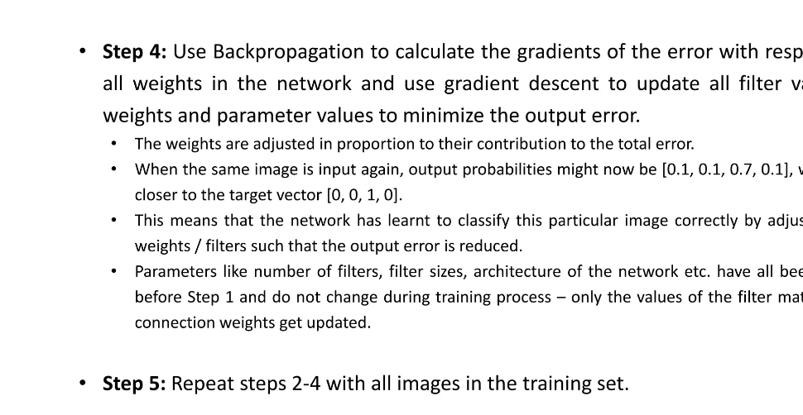

Slide 55
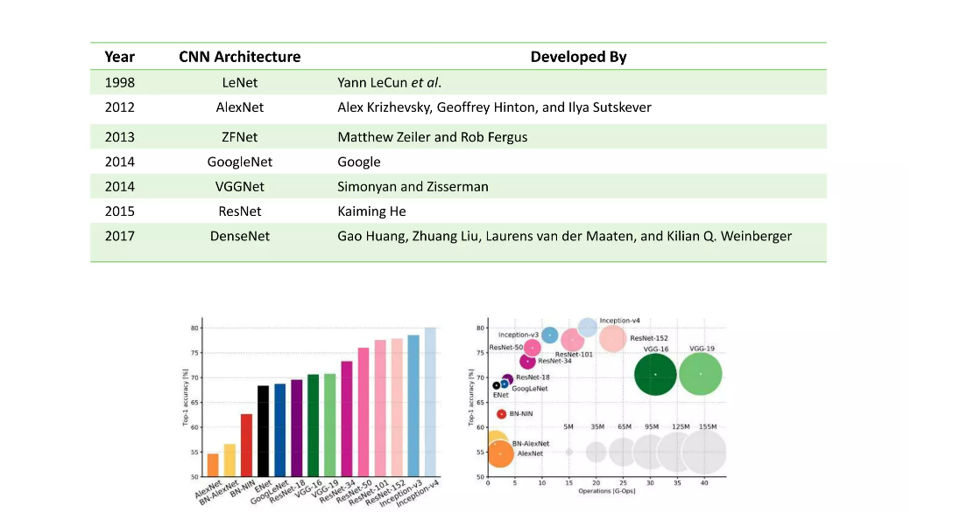

Slide 56
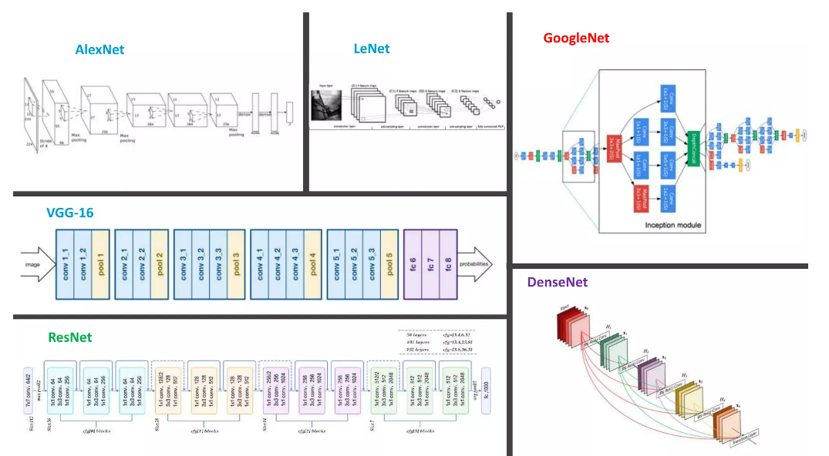

Slide 57
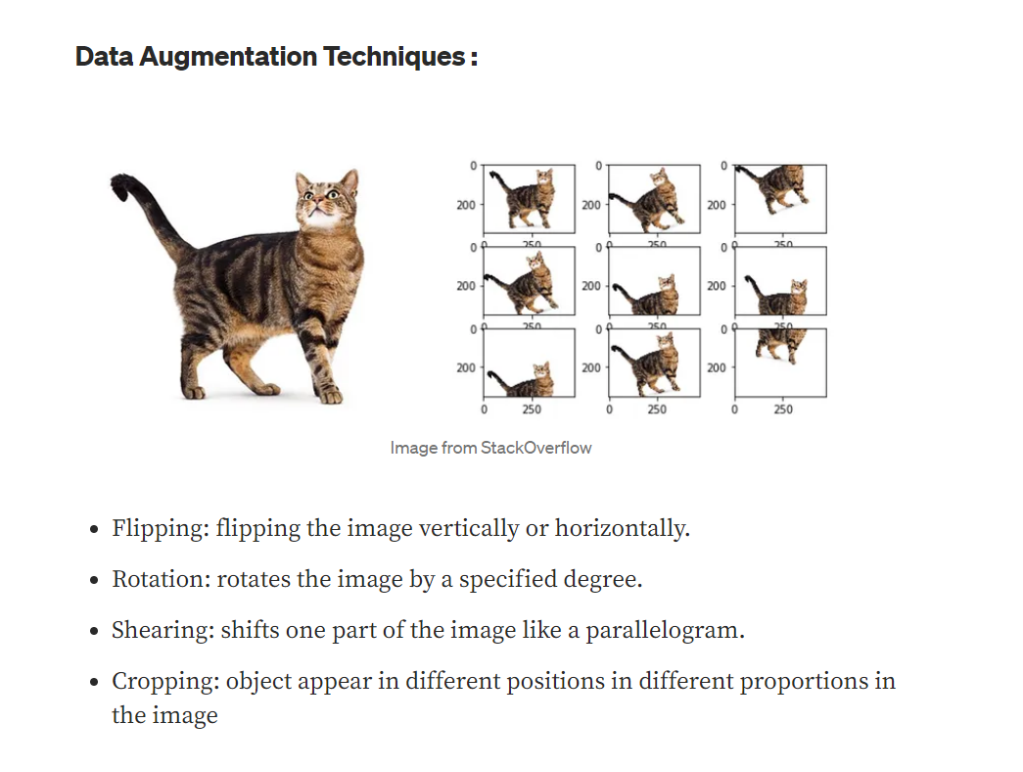

Slide 58

Limitations

Slide 59


Slide 60
Thank you

